Slide 1
Microprocessing Today and Possible Future Solutions
By Marcel Englmaier

Slide 2
Introduction
What is the future of the microprocessor?
What is a processor made of?
Hyperthreading
MOSFETS
Virtualization

Slide 3
The Problem
As processors gain power, and become smaller, there will eventually be a point in time when processors cannot be shrunk anymore by today’s methods due to electrons.
This needs to be addressed now, rather than in 5 to 10 years when it becomes a real problem

Slide 4
Working Definitions
Hyperthreading: “Hyperthreading is a technology Intel developed that can boost PC performance up to 30 percent by enabling a single chip to work like two virtual chips. The feature is currently offered only in Intel Xeon processors targeted for use in workstations and servers.“ (Popovich, 2002).
MOSFET - Metal Oxide Semiconductor Field-Effect Transistors (Bescond, 2009)
Shrinking the processor – Refers to the distance between transistors being made smaller, not the actual processor dimensions.
Parallel computing – use of multiple cores for one or more tasks.
Virtualization – a form of Hyperthreading
Free electrons- electrons jumping from circuit to circuit inside the processor.

Slide 5
Limitations
No cost of production for any of the items
Desktop computing, the micro-processor.
No Full-sized processors
No mobile computing
No in depth discussion of multi-core processing, and parallel computing.

Slide 6
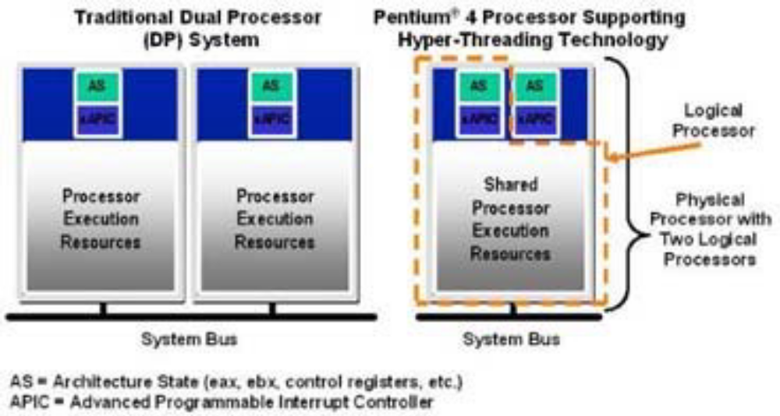
Hyperthreading
Invented in 2002 by Intel for use in servers in the Pentium II
Killed off due to the Pentium II.
Brought back in 2009

Slide 7
Cache Size
What is Cache
Level 1-individualized
Level 2-shared
Level 3-shared

Slide 8
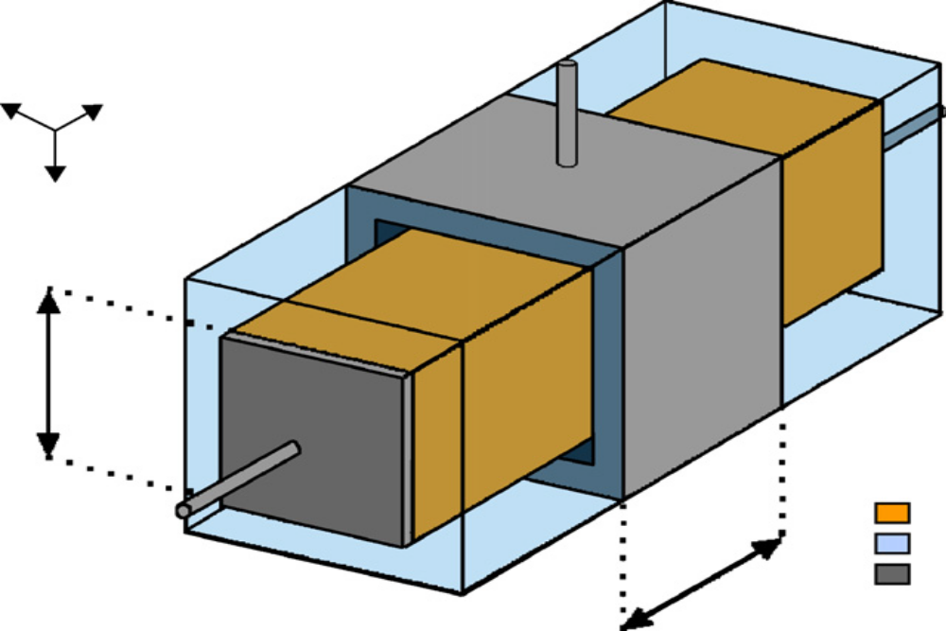
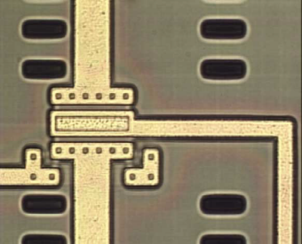
Transistors
Using MOSFETs
What is the issue with the current transistors?
Nanowire Transistors

Slide 9
Manufacturing Materials
Pure Metals
Silicon
impurities

Slide 10
Turbo Boost(Turbo Core)
What is overclocking?
What does the Turbo Boost do?

Slide 11
Conclusion
What can be done?

Slide 12
References
Bescond, M. M., Lanoo, F., Michelini, L., & Raymond, M. G. P. (2009). 3d real-space quantum transport simulation of nanowire mos transistors: influence of the ionized doping impurity. Microelectronics Journal, 40(4-5), 756-758. doi: 10.1016/j.mejo.2008.11.009
Crisp, S. (2009). What makes core i7 special. Personal Computer World, (01420232), n/a-n/a. Retrieved from http://search.proquest.com/docview/213521422?accountid=15099
Hyper-threading. Wikipedia. Wikipedia. Retrieved from http://en.wikipedia.org/wiki/Hyperthreading
Ivanov, L. (2012). The right balance: restructuring the parallel and scientific computing course. Journal of Computing Sciences in Colleges, 27(3), 115-121. Retrieved from ACM Digital Library
Madhura, A. Phatak. V., & Dongaonkar Jr., B. R. (2009). Applying hyperthreading technology for evaluating the performance of http server for stored audio/video retrieval. Emergin Trends in Engineering and Technology (ICETET), 2009 2nd International Conference, 644-647. doi: 10.1109/ICETET.2009.39
Popovich, K. (2002). Chip sets boost performance ; intel adds support for hyperthreading, faster bus and memory speeds. EWeek, 19(41), 28-28. Retrieved from http://search.proquest.com/docview/198521427?accountid=15099
Rai, J. K., Negi, A., Wankar, R., & Nayak, K. D. (2009). Characterizing l2 cache behavior of programs on multi-core processors: regression models and their transferability . Nature & Biologically Inspired Computing, 1673-1676. doi: 10.1109/NABIC.2009.539364
Saetang, D. (2010, Geektech. PC World, 28(6), 16-16. Retrieved from http://search.proquest.com/docview/347288178?accountid=15099
Sheinberg, B. (2009). Intel goes small to go big. CRN, , A.9-A.9. Retrieved from http://search.proquest.com/docview/227583499?accountid=15099
Simons, J., & Buell, J. (2010). Virtualizing high performance computing. ACM SIGOPS Operating Systems Review, 44(4), doi: 10.1145/1899928.1899946
Wang, X., Zang, J., Wang, Z., Luo, Y., & Li, X. (2011). Selective hardware/software memory virtualization. ACM SIGPLAN Notices - VEE '11, 46(7), doi: 10.1145/2007477.1952710
Wieland, R., Bonfert, D., Klumpp, A., Merkel, R., Nebrich, L., Weber, J., & Ramm, P. (2005). 3d integration of cmos transistors with icv-slid technology. Microelectronic Engineering, 82(3-4), 529-533. doi: 10.1016/j.mee.2005.07.052

